Slide 1
Intro to Neural Network 2
Marlabs

Slide 2
Deep Learning
We’ve seen how a single perceptron behaves, now let’s expand this concept to the idea of a neural network!
Let’s see how to connect many perceptrons together and then how to represent this mathematically!

Slide 3
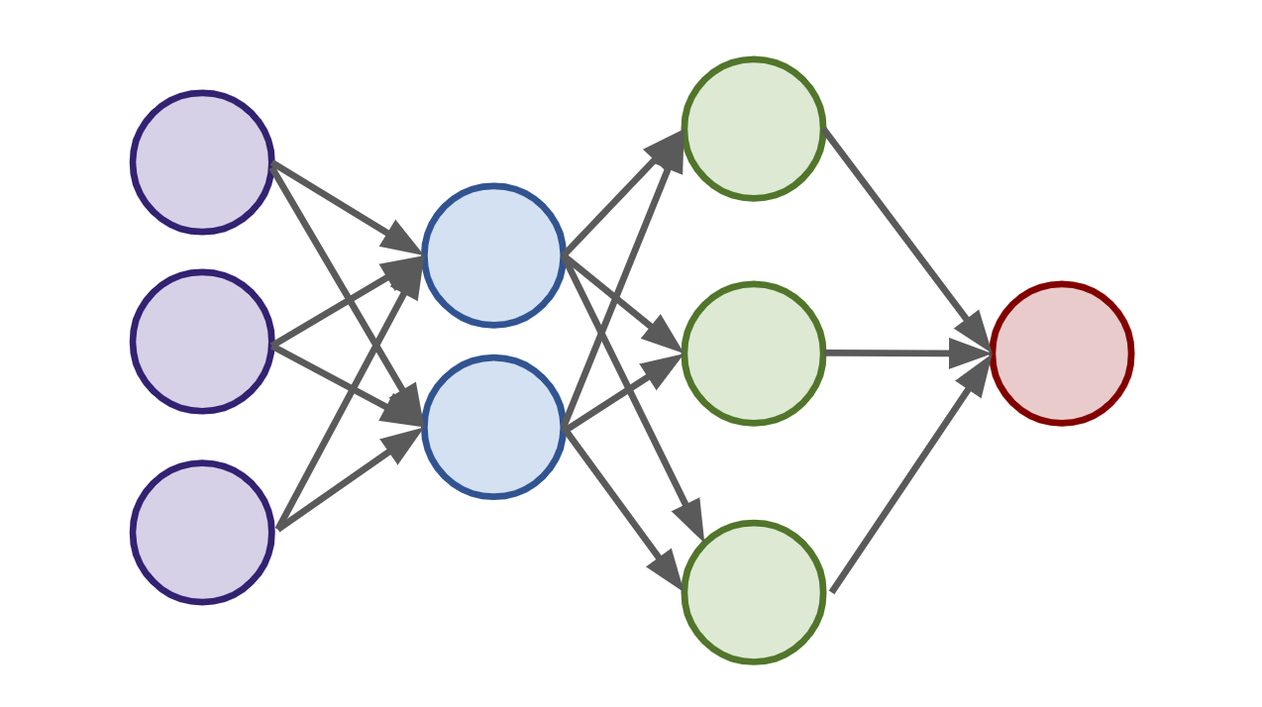
Deep Learning
Multiple Perceptrons Network

Slide 4
Deep Learning
Input Layer. 2 hidden layers. Output Layer

Slide 5
Deep Learning
Input Layers
Real values from the data
Hidden Layers
Layers in between input and output
3 or more layers is “deep network”
Output Layer
Final estimate of the output

Slide 6
Deep Learning
As you go forwards through more layers, the level of abstraction increases.
Let’s now discuss the activation function in a little more detail!

Slide 7
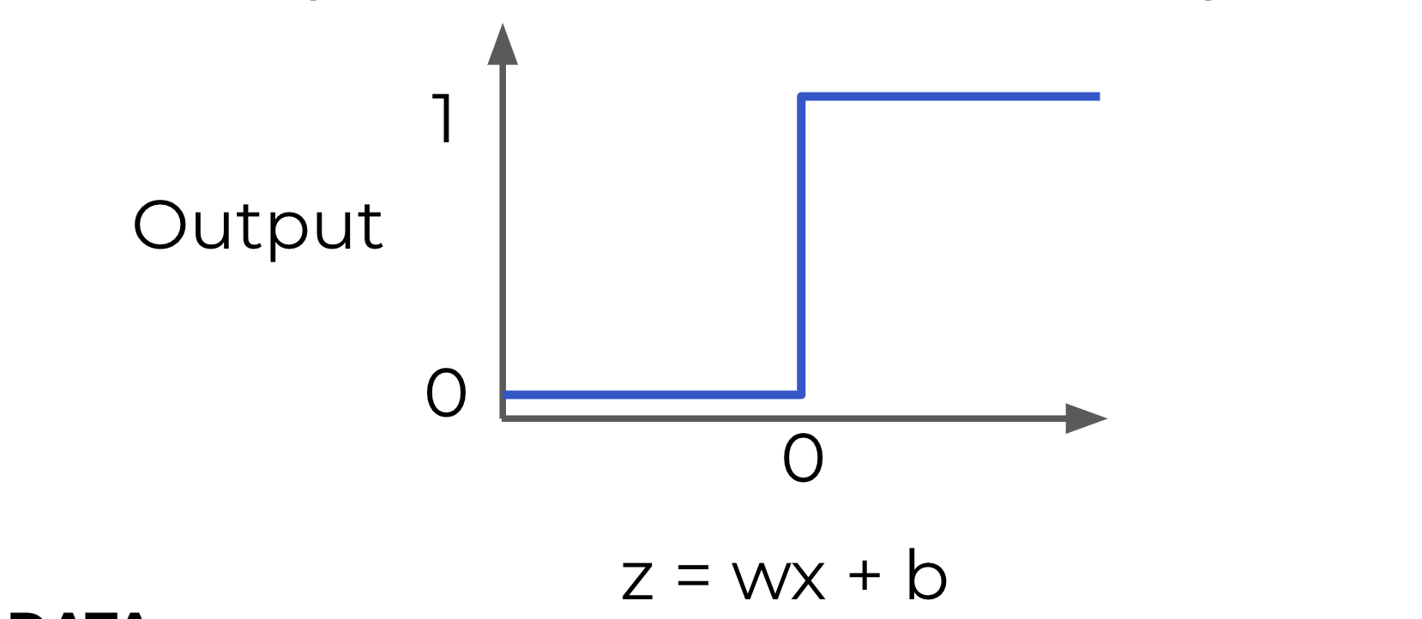
Activation Function
Previously our activation function was just a simple function that output 0 or 1.

Slide 8
Activation Function
This is a pretty dramatic function, since small changes aren’t reflected.

Slide 9
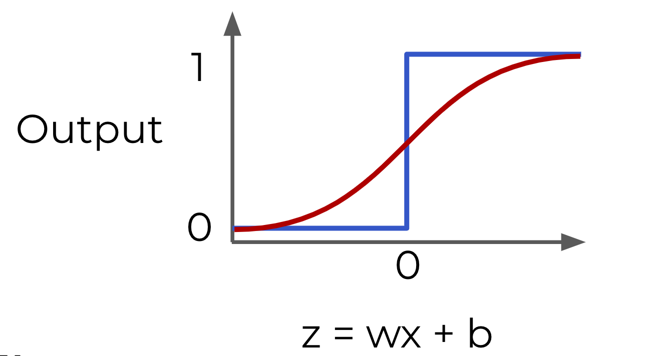
Activation Function
It would be nice if we could have a more dynamic function, for example the red line!

Slide 10
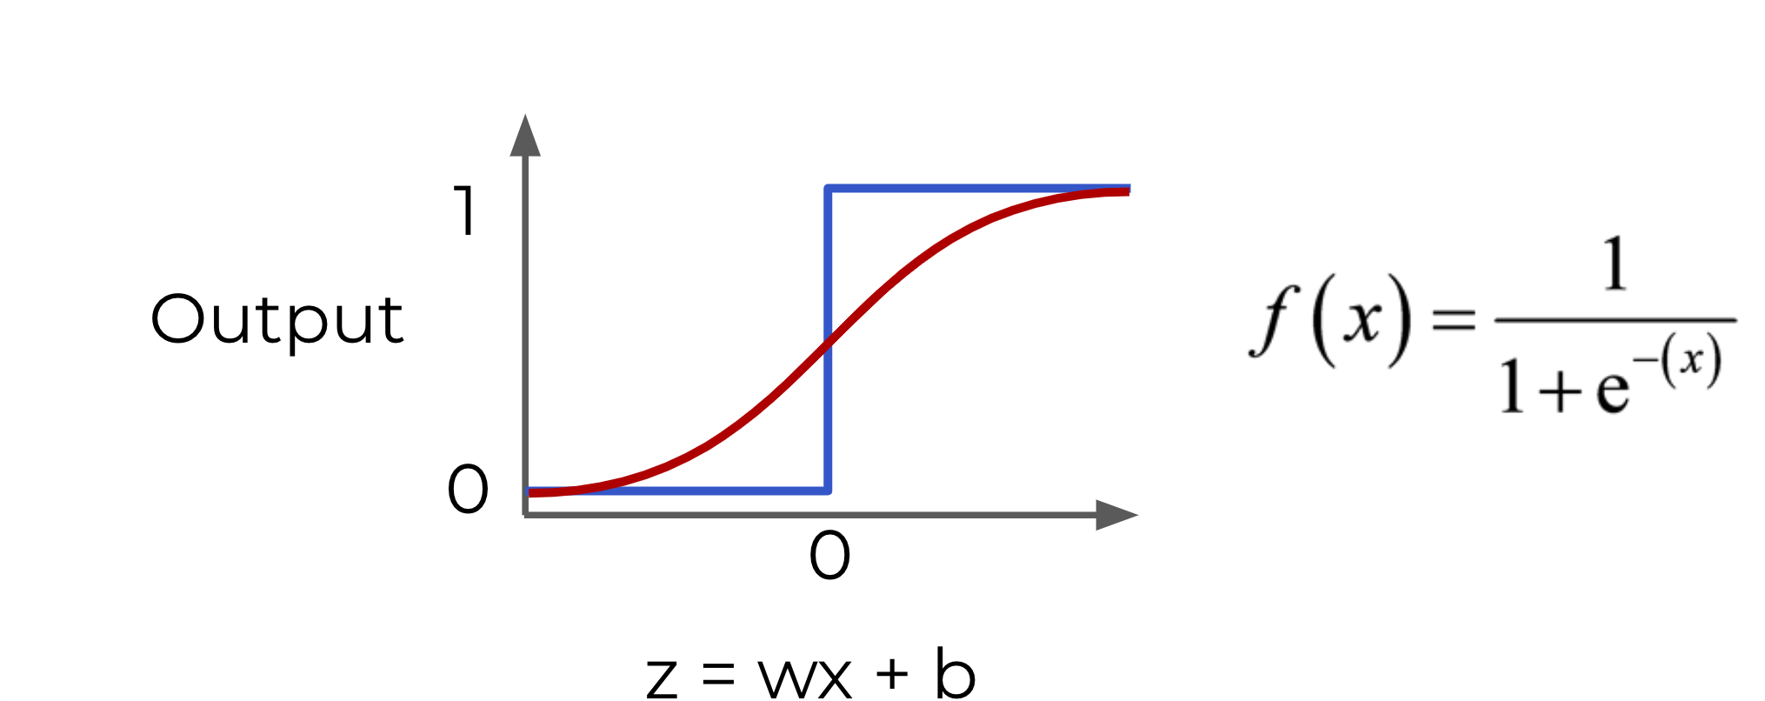
Activation Function – Sigmoid Function
Lucky for us, this is the sigmoid function!

Slide 11
Activation Function
Changing the activation function used can be beneficial depending on the task!

Slide 12
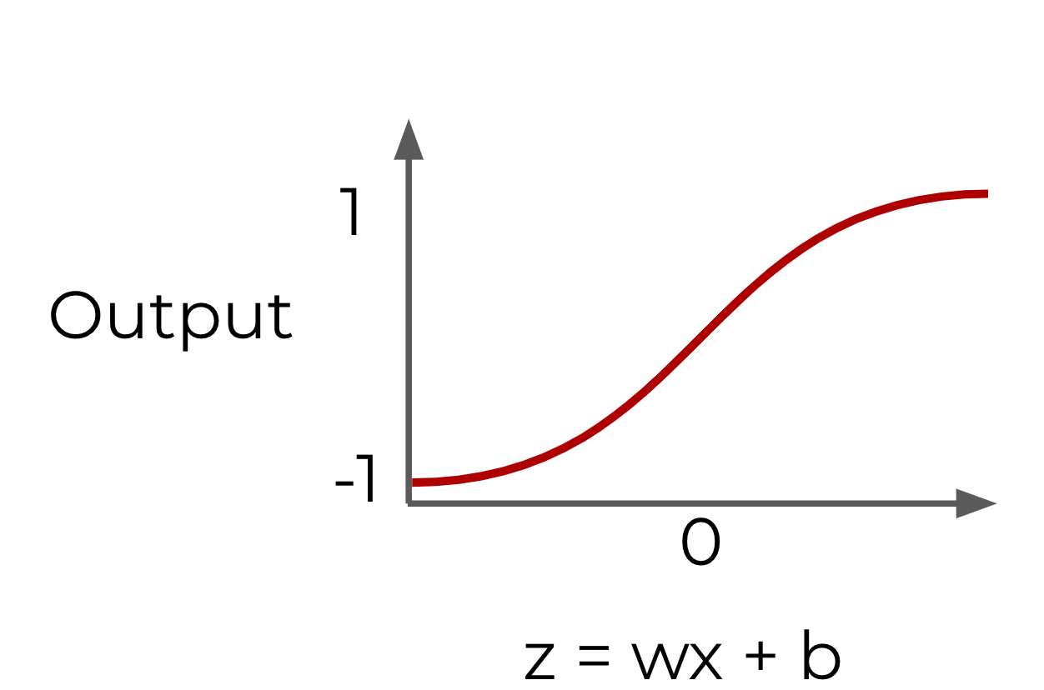
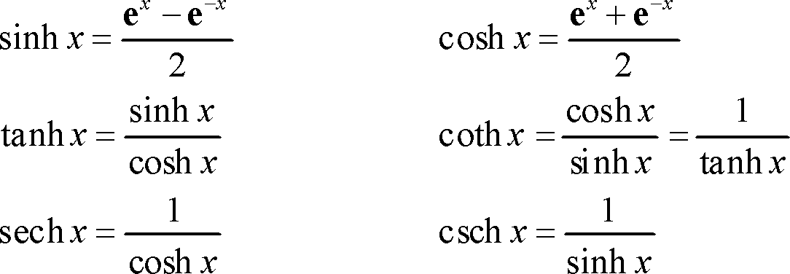
Activation Function – tanh(z)
Hyperbolic Tangent: tanh(z)

Slide 13
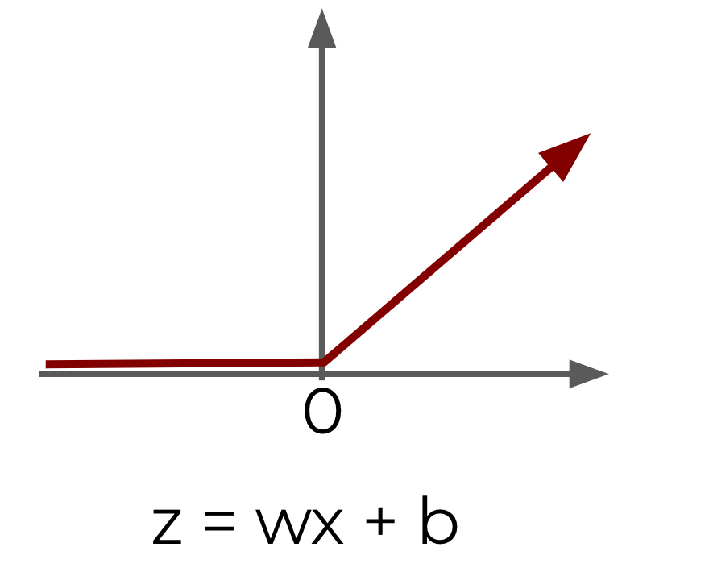
Activation Function - ReLU
Rectified Linear Unit (ReLU): This is actually a relatively simple function: max(0,z)
Output

Slide 14
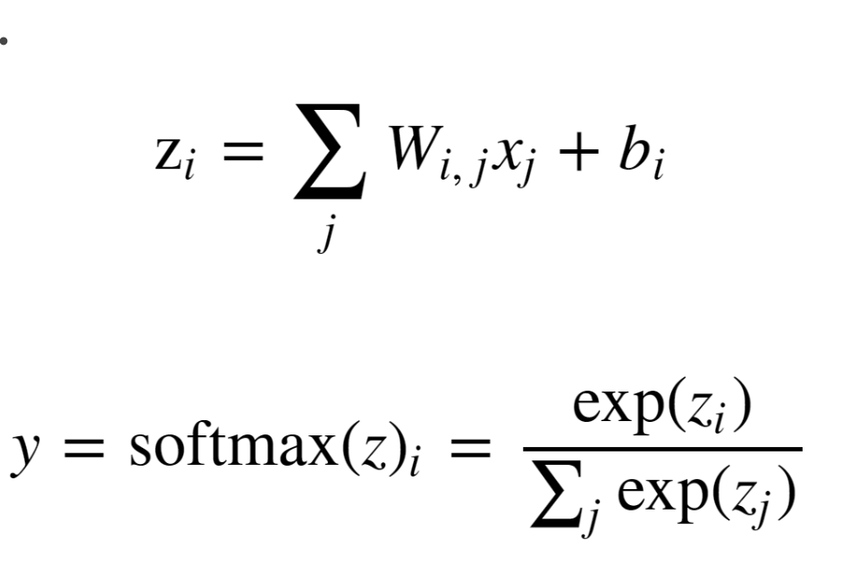
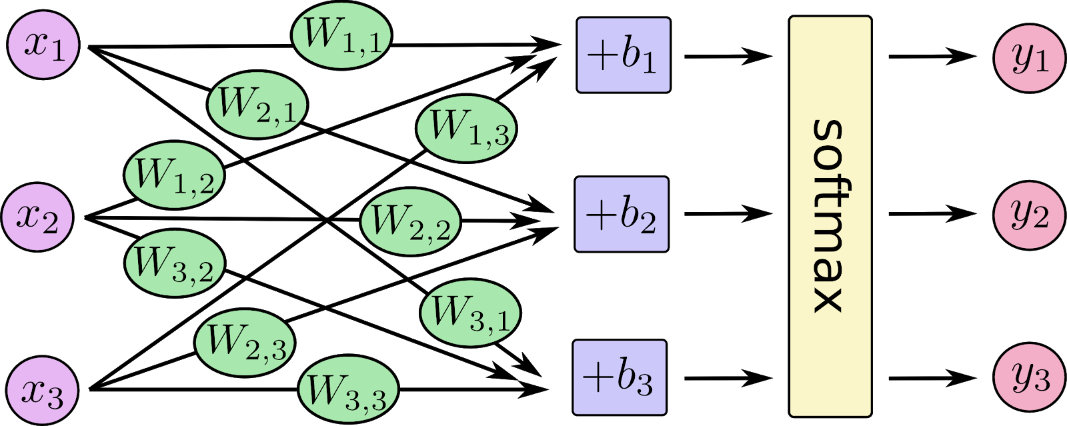
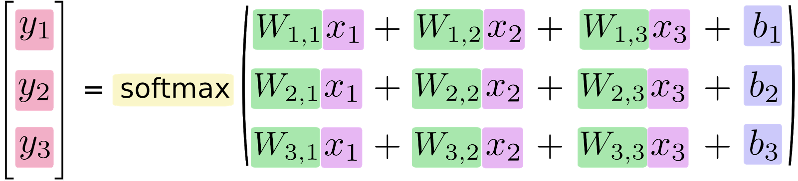
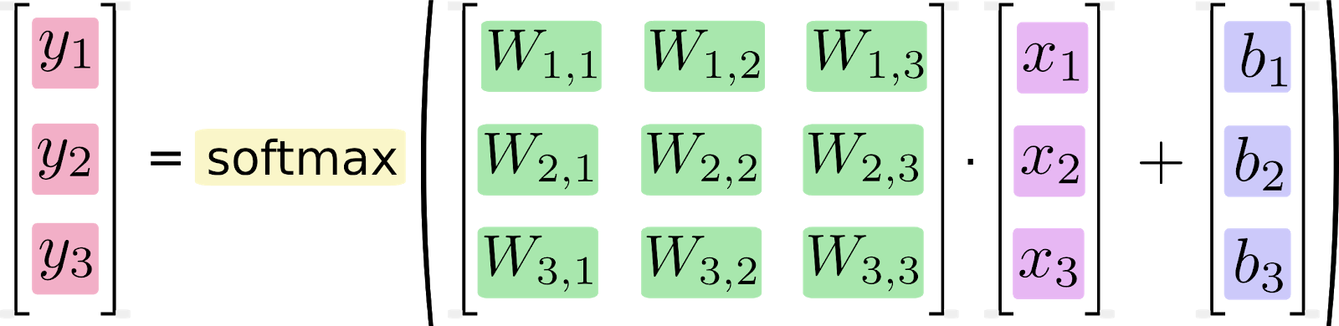
Activation Function - Softmax

Slide 15
Activation Functions
ReLu and tanh tend to have the best performance.
Deep Learning libraries have these built in for us, so we don’t need to worry about having to implement them manually!

Slide 16
Cost Functions
Let’s now explore how we can evaluate performance of a neuron!
We can use a cost function to measure how far off we are from the expected value.
We’ll use the following variables:
y to represent the true value
a to represent neuron’s prediction
In terms of weights and bias:
w*x + b = z
Pass z into activation function σ(z) = a

Slide 17
Cost Function
Quadratic Cost
C = Σ(y-a)² / n
We can see that larger errors are more prominent due to the squaring.
Unfortunately this calculation can cause a slowdown in our learning speed.

Slide 18
Cost Function – Cross Entropy
Cross Entropy
C = (-1/n) Σ (y⋅ln(a) + (1-y)⋅ln(1-a))
This cost function allows for faster learning.
The larger the difference, the faster the neuron can learn.
We now have 2 key aspects of learning with neural networks, the neurons with their activation function and the cost function.
We’re still missing a key step, actually “learning”!

Slide 19
Gradient Descent
We need to figure out how we can use our neurons and the measurement of error (our cost function) and then attempt to correct our prediction, in other words, “learn”!
Gradient descent is an optimization algorithm for finding the minimum of a function.
To find a local minimum, we take steps proportional to the negative of the gradient.

Slide 20
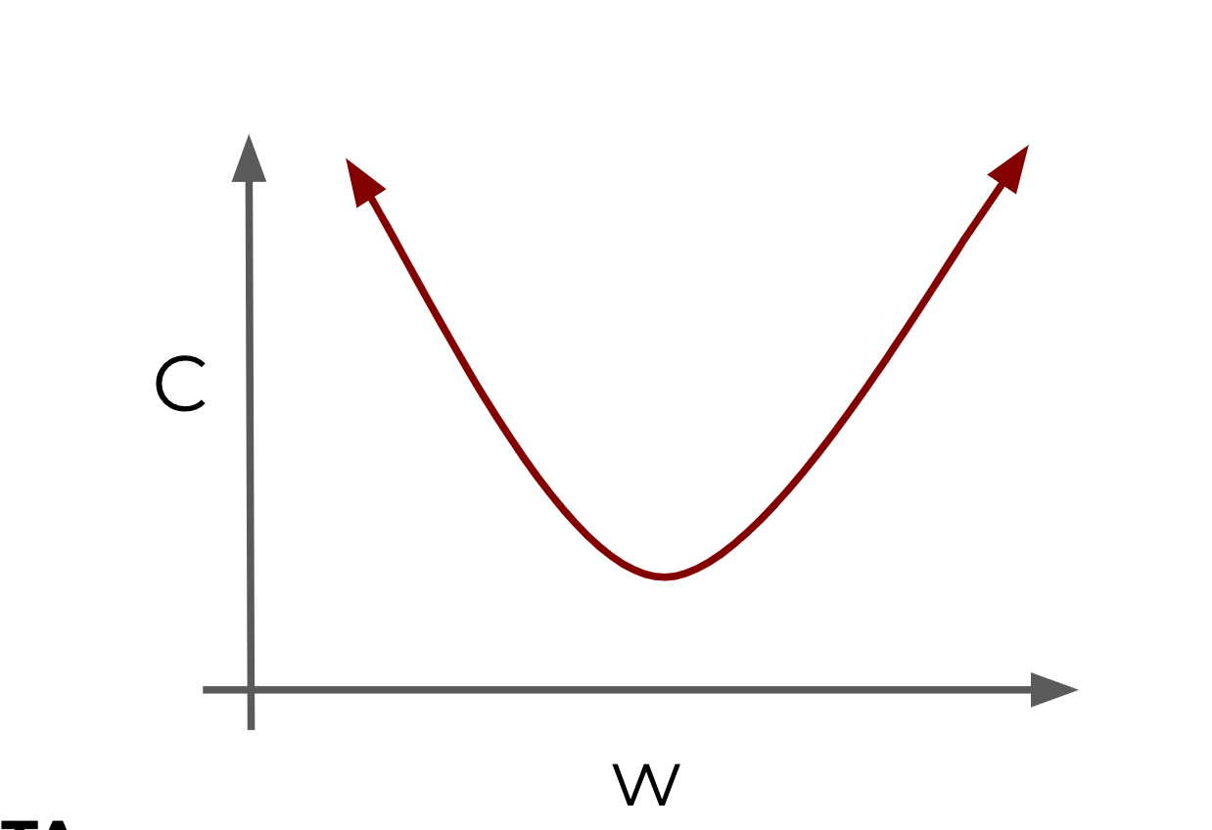
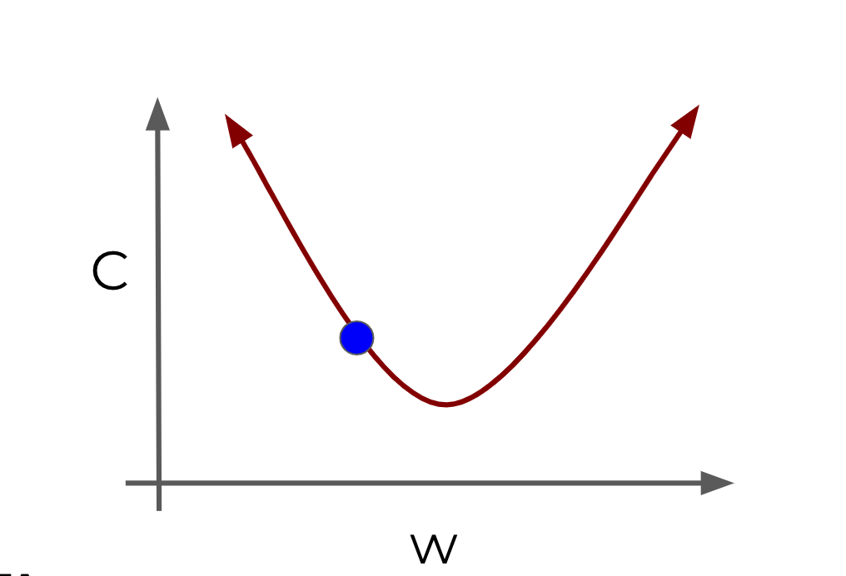
Gradient Descent
Gradient Descent (in 1 dimension)

Slide 21
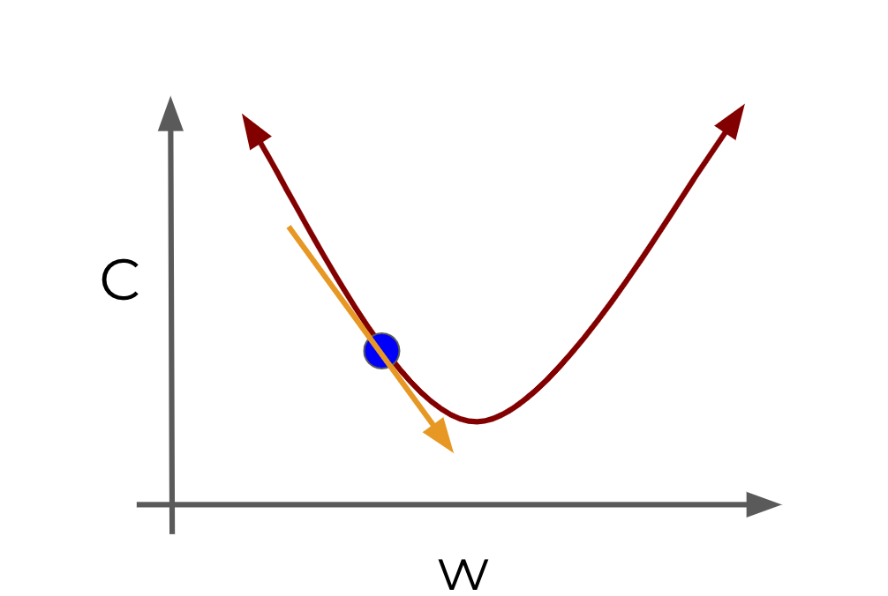
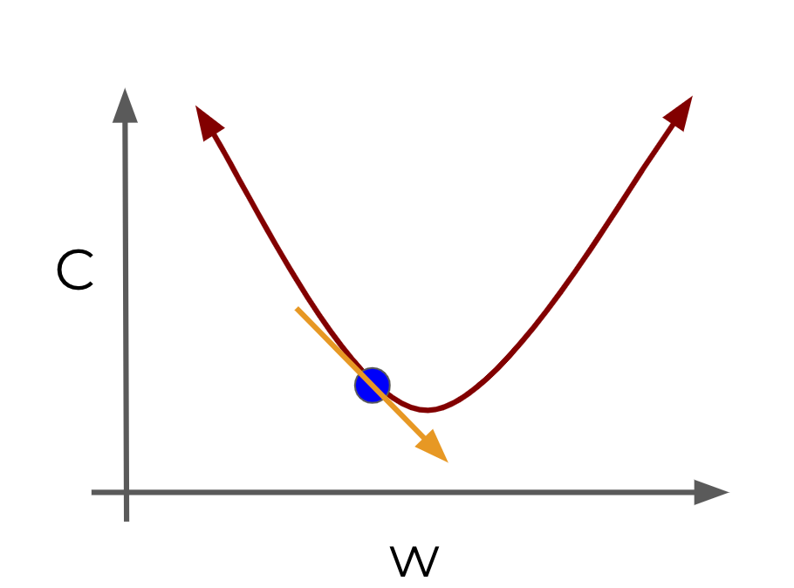
Gradient Descent (in 1 dimension)

Slide 22
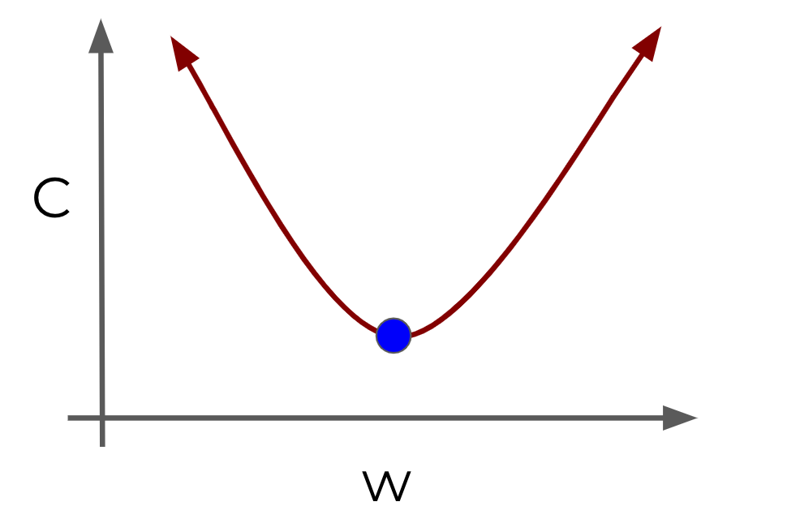
Gradient Descent
Visually we can see what parameter value to choose to minimize our Cost!
Finding this minimum is simple for 1 dimension, but our cases will have many more parameters, meaning we’ll need to use the built-in linear algebra that our Deep Learning library will provide!

Slide 23
Gradient Descent
Using gradient descent we can figure out the best parameters for minimizing our cost, for example, finding the best values for the weights of the neuron inputs.
We now just have one issue to solve, how can we quickly adjust the optimal parameters or weights across our entire network?
This is where backpropagation comes in!

Slide 24
Backpropagation
Backpropagation is used to calculate the error contribution of each neuron after a batch of data is processed.
It relies heavily on the chain rule to go back through the network and calculate these errors.
Backpropagation works by calculating the error at the output and then distributes back through the network layers.
It requires a known desired output for each input value (supervised learning).

